Slide 1
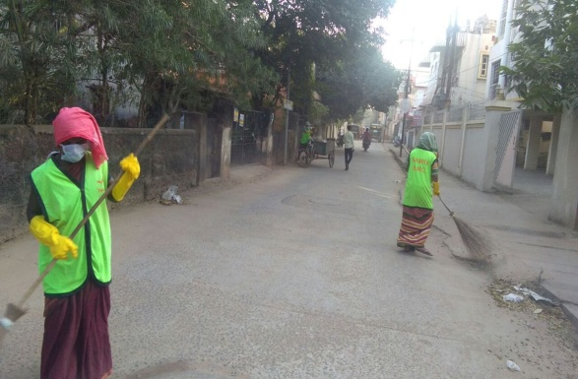
Smart Sanitation for Smart City- An Initiative of IGFP
Sri B.K. Sahu
Former Insurance Commissioner,
ESIC, Ministry Of Labour &
Communication Advisor, Insurance Regulatory Authority (IRDA),
Now Director, Indo-German Focal Point Prevention & Social Security In India
Website:-www.indogermanfocalpoint.com.

Slide 2
Safety & Health –A Reality Check Through Video
Awareness Program for Sanitation Activities 2020
Indo-German Focal Point for India

Slide 3
News Letter of IGFP (Issue –I)
Awareness Program for Sanitation Activities 2020
Indo-German Focal Point for India

Slide 4
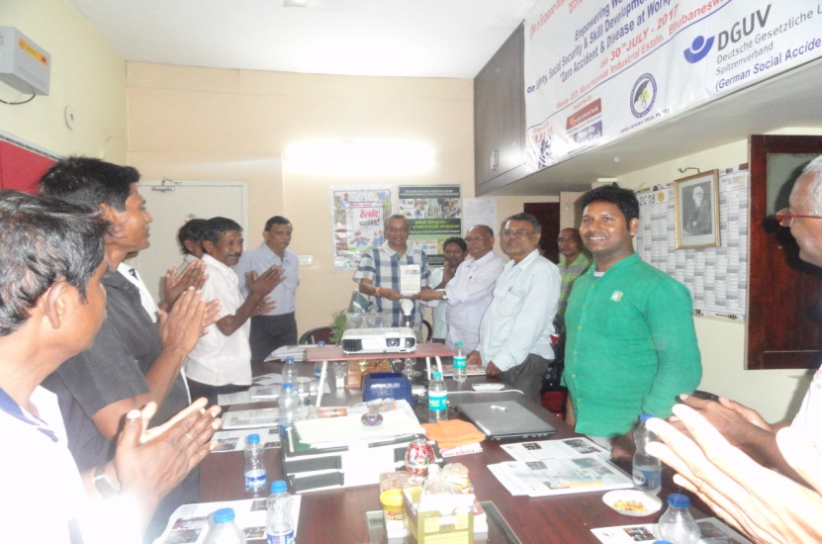
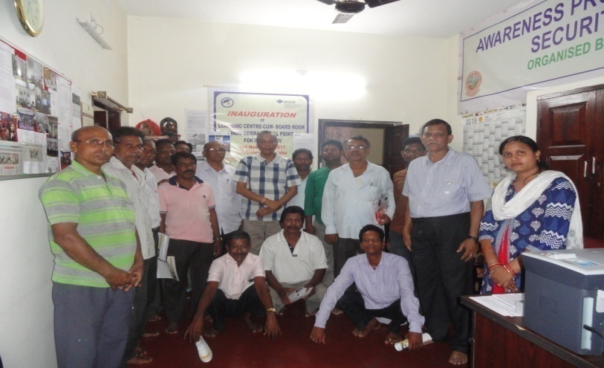
Discussion on Plight of Scavengers/Sweepers on 23.04.2018
Discussion on plight of scavengers/sweepers on 23rd April @ 5.00 pm
bimal sahu <focalpointindia.dguv@gmail.com>
Apr 19
to bcmcitu
Dear Sir
You are most welcome to visit Indo-German Focal Point for India on 23rd April 2018 @ 5.00 pm. We are preparing a presentation highlighting the plight of scavengers/sweepers engaged by Municipalities in general and BMC in particular. So that you can have the feedback for proposed program in May 2018.
It will be appreciated if 2 or 3 colleagues of yours can join the above discussion.
Please find the enclosed newsletter and BMC mails regarding the above discussion.
Awareness Program for Sanitation Activities 2020
Indo-German Focal Point for India

Slide 5
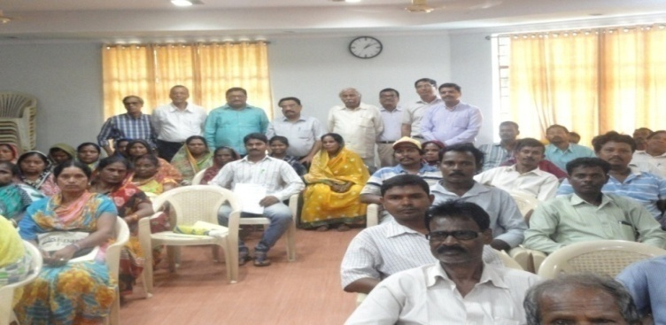
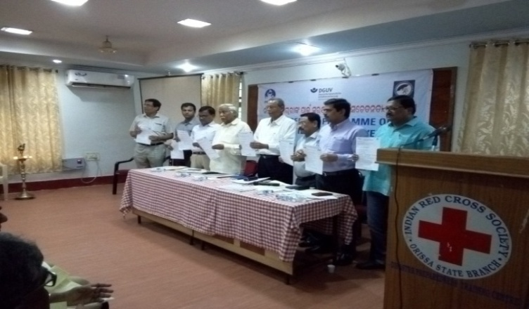
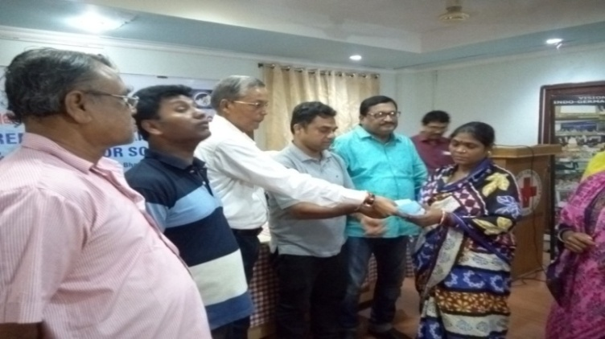
Awareness Program on Safety & Health for Scavengers on 2nd July 2018
A ½ Day Awareness Program on Safety & Health for Scavengers has been jointly organized by Indo-German Focal Point & PECUC(People’s Cultural Center) on 2nd July 2018 at Red cross Bhawan, Bhubaneswar.
On this occasion Questioner was released which was later on filled up by the hundreds of participants(Scavengers/Sweepers) who attended the program.
Different suggestions has come from the guest like coverage under ESI, use of PPE, giving training to the scavengers, their periodical Health Check-up & Vaccination etc for the betterment of quality of life of the scavengers/sweepers.
Safety Equipments like hand-gloves, cap & Face mask is distributed to all the participants by a young start-up Entrepreneur Mr. Dillip Mishra
Awareness Program for Sanitation Activities 2020
Indo-German Focal Point for India

Slide 6
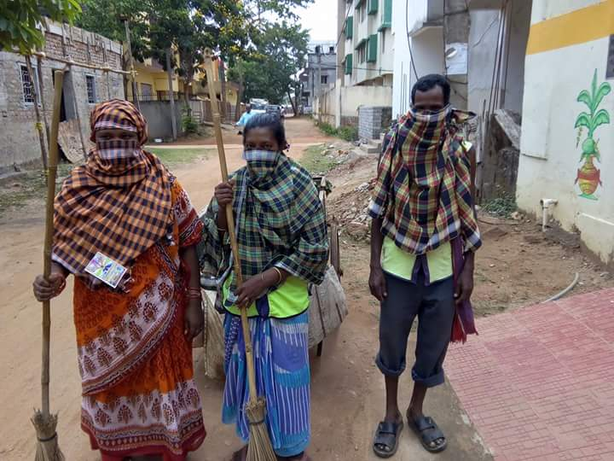
Scavengers-Without & With PPE
THEN
NOW
Awareness Program for Sanitation Activities 2020
Indo-German Focal Point for India

Slide 7
Duties/ Responsibilities of Management / Contractor Engaging Sanitation Workers
→Giving Regular Health Check up of such workers, Provision of PPE like Safety Jacket, Glove Mask & Shoes etc,
Provision of Equipment like Trolley/ Waste Bin with colour coding
Display of Safety Messages in their Jacket & Safety Trolley which will have easy direct impact for Households/Colonies in observing Safety Guidelines like Wear Mask/ Physical Distancing & Frequent Hand Cleaning & Avoiding Crowd to stay Safe,
Payment of Minimum Wages/ Weekly off & Coverage under ESI PF
Construction/Welfare Board of State, Supervisors/ Contractors regularly visiting to oversee Cleanliness & their any Deficiencies/Talking to Local Residents Association for support.
Above Measures help in keeping Scavengers Healthy & Smart to make the Smart city - A Reality.
Awareness Program for Sanitation Activities 2020
Indo-German Focal Point for India

Slide 8
Safety & Social Security Initiatives of MOL, Govt of India-1
The recently adopted Safety Code & Social Security Codes require coverage of all Informal Contact Workers/ Compulsory Registration/Provision of Identity Card/Issue of Appointment/Engagement Letter & importantly coverage under Social Security Schemes of Govt of India/ State Government
Code on Social Security 2020
Social Security A Right Based approach now
Ensures Universalization of Social Security
Recognises for the First Time Migrant Gig Platform & Plantation Workers for Social Security
Retains State Construction Board
Three Tier Structure for Implementation - Central/State/ Other Recognised Body like State Construction Board
OSH & Working Conditions Code 2020
Employer to Issue Appointment/Engagement Letter.
Weekly off, Safety & Social Security for Safe Work Place.
Issue of Identity Card.
Awareness Program for Sanitation Activities 2020
Indo-German Focal Point for India

Slide 9
Latest Welfare Scheme for Scavengers by Govt of Odisha-September 2020-II
Under ‘GARIMA’ scheme:
→Around 20,000 core sanitation workers and their families with about one lakh population will benefit from the scheme.
→GARIMA Scheme will be implemented by the state Housing and Urban Development department in all the 114 Urban Local Bodies (ULBs) of Odisha.
→Initially, the state government has allocated a corpus fund of Rs 50 crore for the scheme.
→The working hours of sanitation workers will be limited to 6 hours per day.
→The Core Sanitation workers and their family members will be covered under the health insurance scheme with regular health check-ups, housing, educational support, mobility support and mobile support.
Source on TOI 11th Sep 2020
Awareness Program for Sanitation Activities 2020
Indo-German Focal Point for India

Slide 10
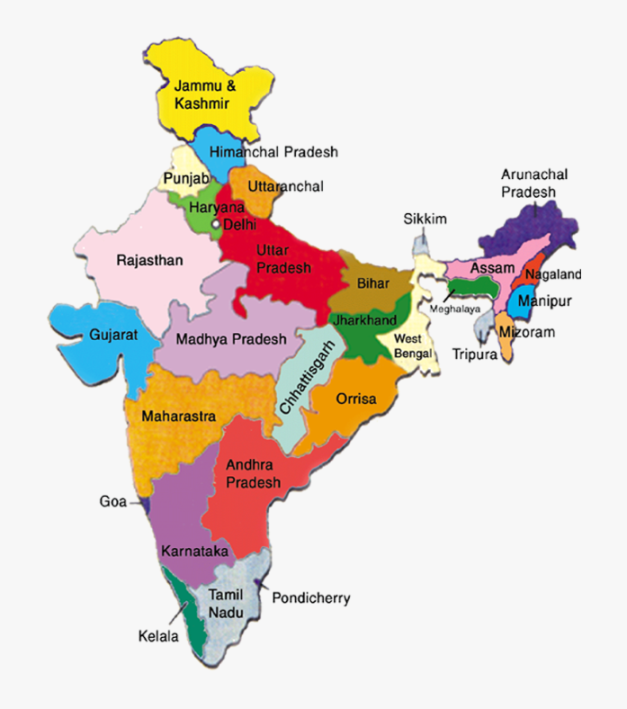
Impact: Through State Visits &
National/International Programs
Summary of Impact(Individuals/Institutions 18,918/884 in 32 Countries)
Number of International Symposium coordinated (with Labour Departments of Odisha, Kerala, Tamilnadu, Gujarat & Karnataka): 5
Number of Programs : 80 [including State Visits, Awareness Programs, Review meetings of IGFP, International workshops & Street plays, etc. ]
Safety Song and Video Contest 2019/ International media Festival contest 2019.
Knowledge sharing through centre of excellence, KIIT Bhubaneswar.
5. Publications and Brochures.
NOW 2020[19 states]
THEN 2017
UP
Bihar
Rajasthan
Practical Implementation of Vision Zero Golden Rules in Industries through Review Meetings, Awareness Programs, Street Plays & Drawing Competition.
Odisha
Union Territory of Chhattisgarh
Andhra Pradesh
Awareness Program for Sanitation Activities 2020
Indo-German Focal Point for India

Slide 11
Zero to Vision Zero
Vision Zero Mutual Commitment from Owners, Leaders and workers
Policies, Planning, Procedures and practice All (serious) accidents and occupational diseases are preventable A process – Not a goal
2020
2017
From
Pillars for VISION ZERO
Zero
Take Leadership – Demonstrate commitment.
Identify hazards – Control risk
Define targets – Develop Programs
Ensure a Safe and Healthy Sysems
Vision
Impact of OSH Activities of IGFP With strong support of DGUV, BGBAU,BGETEM & BGHW-IV
Awareness Program for Sanitation Activities 2020
Indo-German Focal Point for India

Slide 12
Winning Video of KIIT on Safety @ World Safety Congress Canada 2020 – English Subtitles Prepared by IGFP
Awareness Program for Sanitation Activities 2020
Indo-German Focal Point for India

Slide 13
ATTITUDE
A+T+T+I+T+U+D+E 1+20+20+9+20+21+4+5 = 100%
It is OUR ATTITUDE towards Life and Work that makes OUR Life 100% ! ! !
Awareness Program for Sanitation Activities 2020
Indo-German Focal Point for India

Slide 14
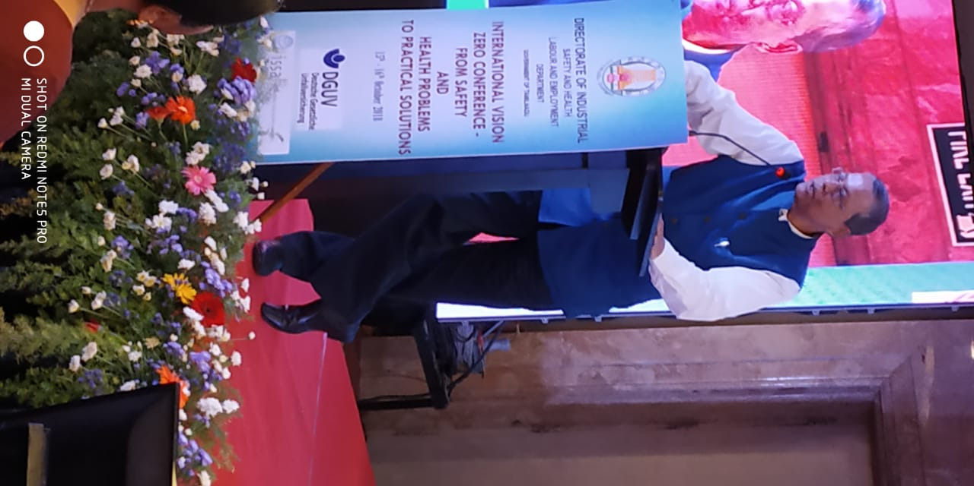
Former Insurance commissioner,
ESI Corporation, Govt. of India & Communication Advisor, IRDAI
bk_sahu04@yahoo.com
focalpointindia.dguv@gmail.com
www.indogermanfocalpoint.com VIEWS EXPRESSED ARE PERSONAL
Thank You

