Slide 1
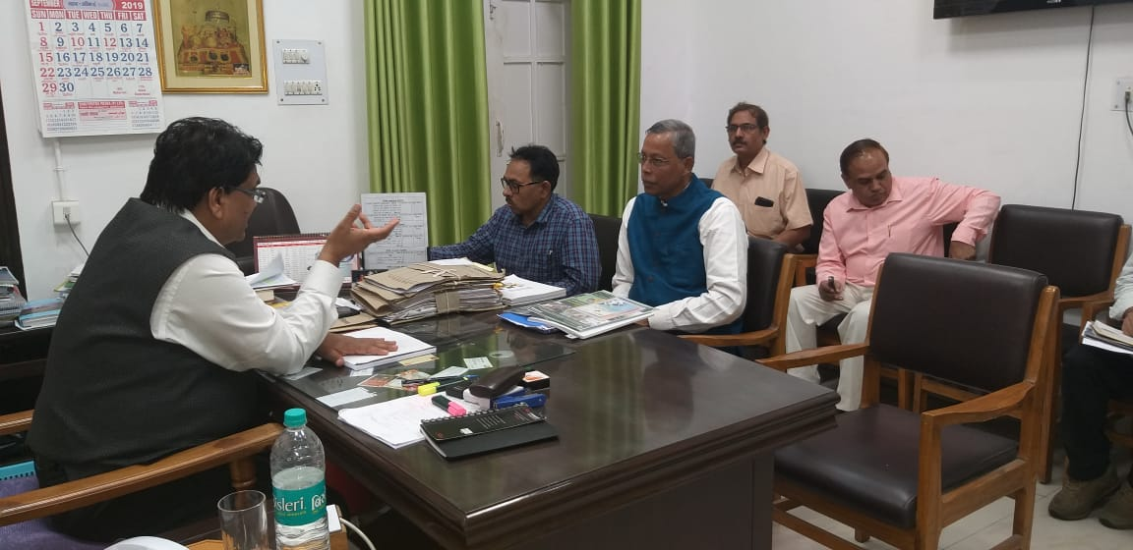
Visit to Lucknow, UP for Meeting with Principal Secretary and senior officers of Labour Department , UP on 30th September 2019 for Activities of Cooperation on OSH.
Decision Taken for Further Action
1.Training program for officers of Directorate of Factories, U.P. through State Level at Lucknow with support of DGUV/BGBAU/BGETEM etc. with coordination of IGFP Principal Secretary directed the concerned officers to further go through financial implications as well as logistic details for having such event and subsequent second round of discussion with Mr. B.K Sahu for future course of action for the program.
2.Exchange program to learn good practices on OSH between DGUV/BGBAU and Labour department of U.P. with coordination of IGFP as suggested by Additional LC and Principal Secretary Labour.
3.Vision Zero as a part of strategy to ensure safe working condition in factories may be discussed in the monthly review meeting of senior officers by Principal Secretary Labour.
4.Principal Secretary brought out the need for international symposium with partnership of leading Employers Associations etc. for which support of DGUV/International speakers may be worked out.

Slide 2
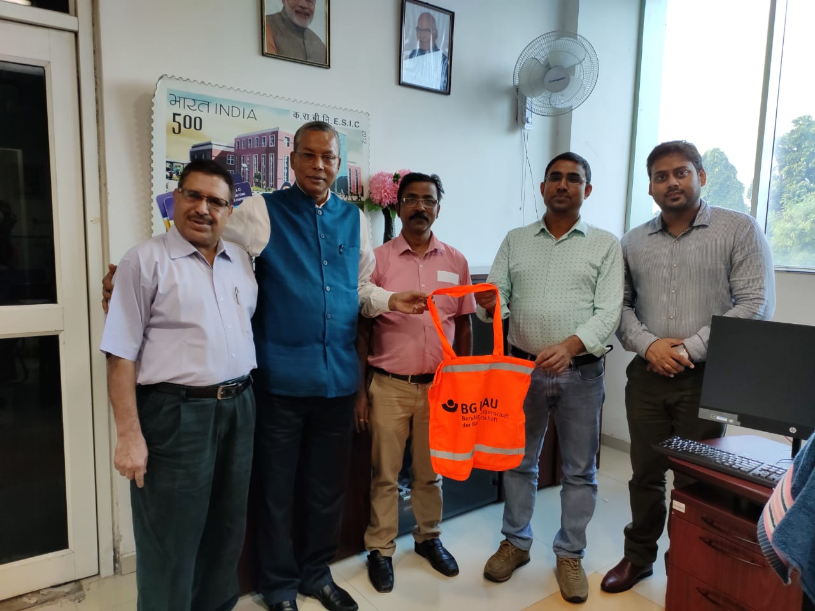
Visit to IIM (Lucknow) & SRO ESIC,UP
we have discussed on these following 3 Areas for, mutual benefit for all concerned-
1. Corporate Training on OSH for industries and other stakeholders like Trade unions, Safety Activists & Management Consultant ect with Partnership of IIM Lucknow & IGFP supported by our, International Supporters like DGUV & BGBAU/ BGETEM, Germany,
2. OSH in MDP/ PG Programs for which details can be worked out & to that extent IIM, Lucknow can be A Game Changer among IIMs in India- in fact creating A Knowledge Sbaring Platform which can, be Professional & Commercial angles
3.IIM Lucknow can be A Partner in IGFP plan to Develop Vision Zero India Program for, which I am forwarding my mail sent to Director IIM Lucknow, besides response received from III Meghalaya.

Slide 3
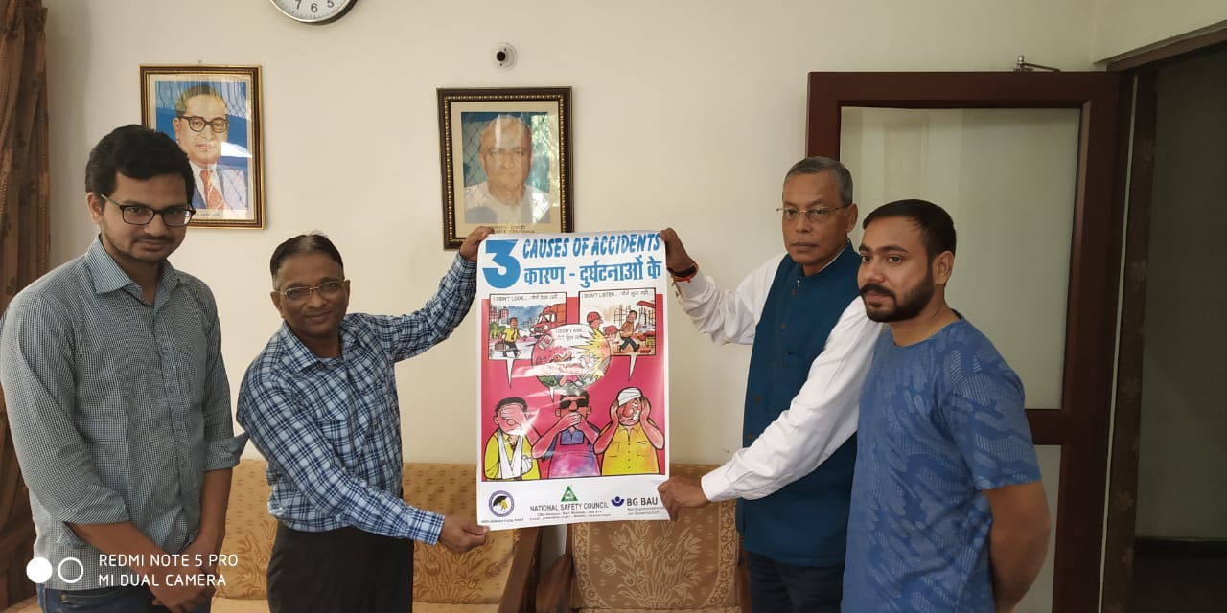
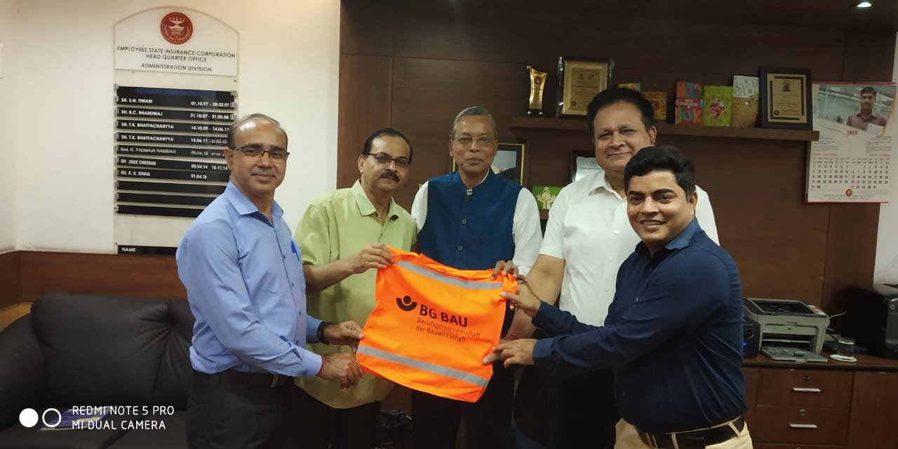
Visit to Delhi For Strengthening OSH Activities /Goodwill Visit on 3rd October 2019
. Discussion with Mr. Vrijesh Upadhaya, National Secretary, BMS.
.Visit to ESIC HQs.
.Visit to MOL.
.Visit to German Ambassador Residence for German Day Celebration .

