Slide 1
SAFETY AND SOCIAL SECURITY –EMPOWERING WORKERS,ENTREPRENEURS & SENIOR CITIZENS BY EDUCATIING CHILDREN, STUDENTS AND WOMEN THAT ZERO ACCIDENT AND DISEASE AT WORK PLACE IS POSSIBLE

Slide 2
Child labour Migrants

Slide 5
The Present Scenario in India Safety
403,000 people in India die every year due to work related issues
There are 46 deaths every hour
9 out of every 100 employees meet with work related accidents annually
Fatal accident frequency rate in the construction sector is 15.8 per 1000 employees against 0.23 in USA
Every 2 minutes a person dies in a road accident. 3% of total GDP is lost annually

Slide 6
FEW FACTS ABOUT SOCIAL SECURITY
In a country of one billion population, hardly 20% of population stands covered into some or other social security schemes that too in organized sector. Those are namely ESI Act, PF Act, RSBY of Government of India, besides commercial Insurance Schemes of public and private ones administered by LIC, GIC and SBI etc.
Any country less than 223 Doctors and nursing staff per 10,000 population faces a crisis (As per WHO study). India has 19, considerably much less in States like Bihar, Jharkhand, Odisha and U.P. The problem is acute in rural areas where majority of Indians live.
Private sector provides more than 70% of the hospital beds only 10% to 20% of population have public health care. (McKinsey Study).
India’s health Budget for 2015-16 is 2% of GDP resulting in out-of-product expenses amounting to almost 60 to 70% of income of general public.
Some 300 million Indians slip into poverty if they face health problem.
10 million domestic workers in our country - no social security in any form.
Approximately 40 million construction workers in the country and only 4 million stands covered under Insurance schemes.

Slide 7
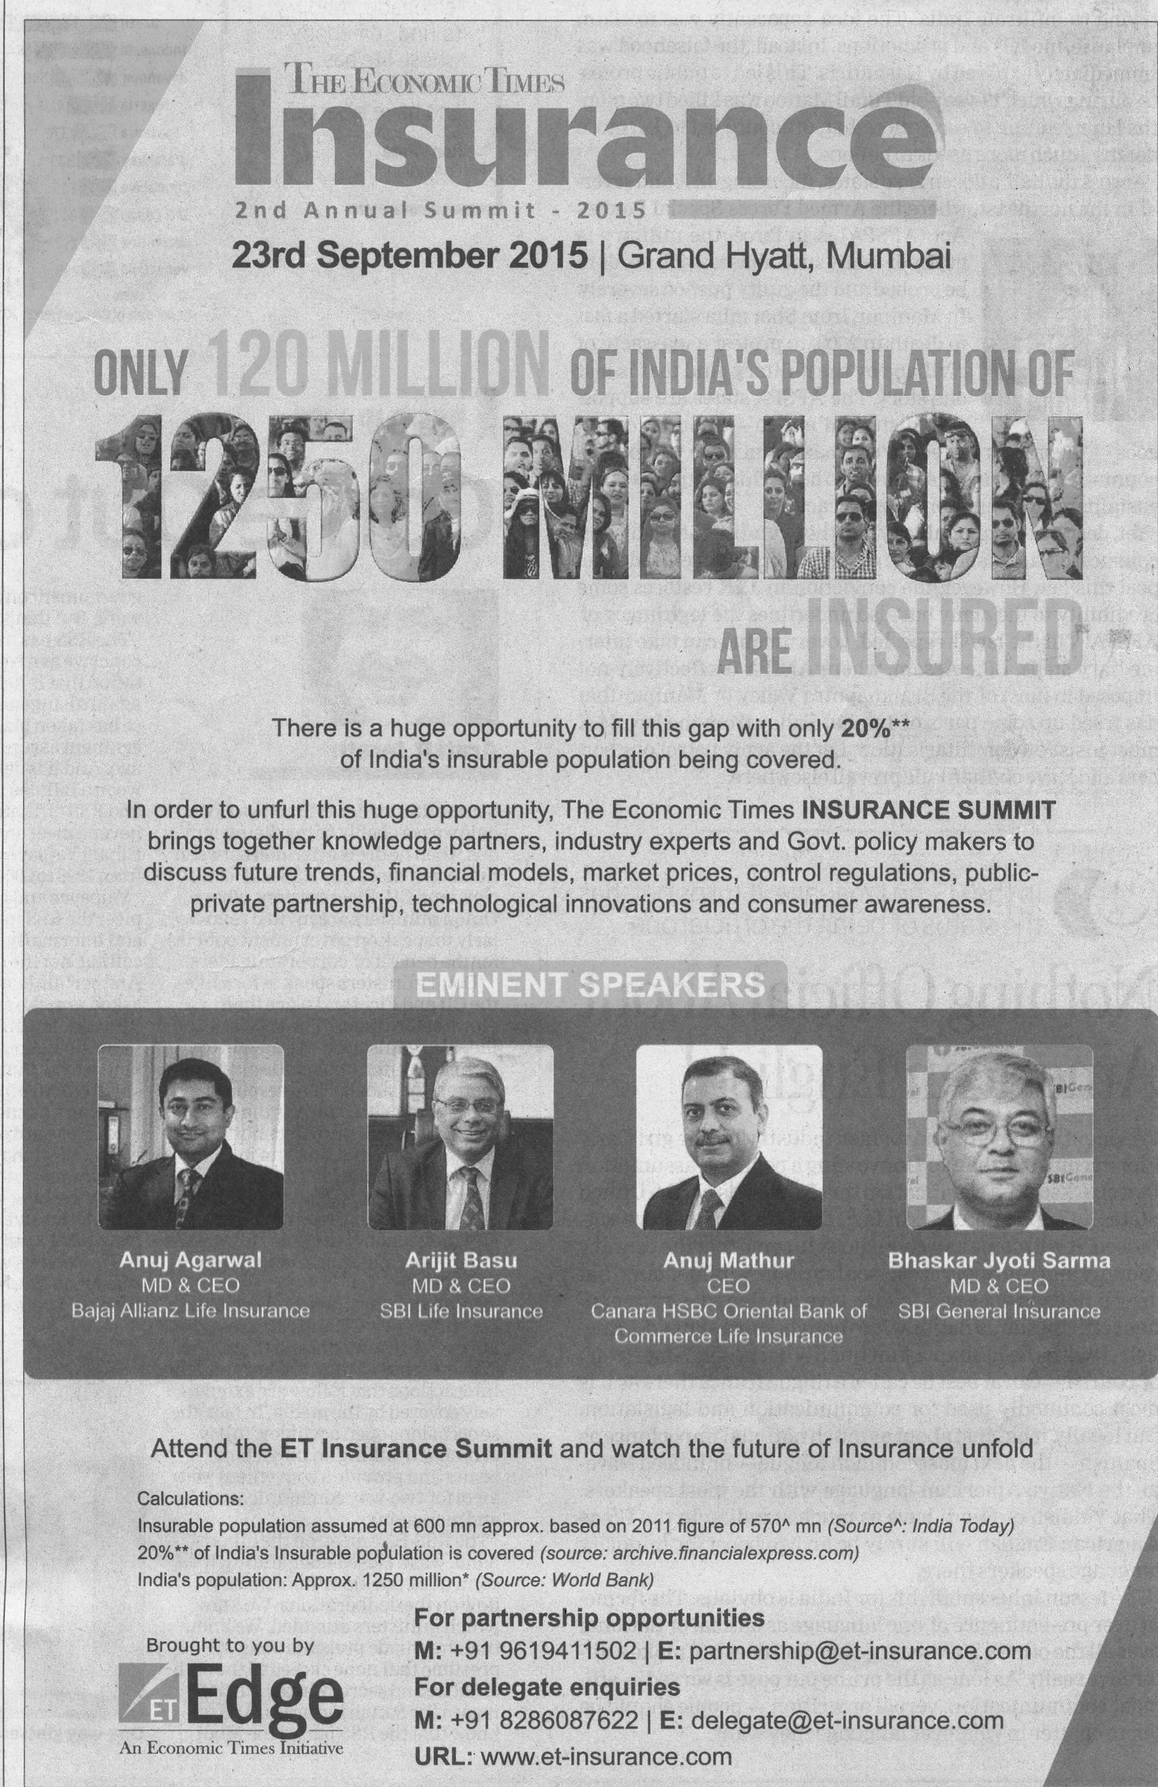

Slide 8
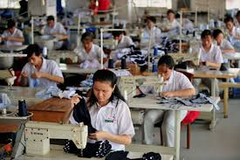
Why Safety & social security are important
Maximum contractualization of jobs.
Migratory nature of workers - LPG Era.
Maximum unorganized workers (90%)
Important tool for prevention and alleviation of poverty.
Acts as a stabilizer during economic slowdown by injecting resources to economy.
Enhances productivity (a win-win situation for employers and industrial houses)
Brings skilled development.
Human dignity and social justice.
Economic and social development.
Prevents social unrest.

Slide 9
Safety is a cultural issue
Safety is a mind set. It is reflected in our behavior

Slide 10
Prevention through Pictures
Workshop on Occupational Health & Safety (OHS) of Construction Workers
Carolin König
10/04/2017

Slide 11
Project by the International Social Security Association Section on Construction
Carolin König
10/04/2017
2

Slide 32
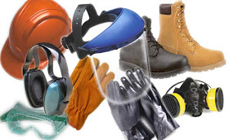
The 5 Common Myths
Myth – Zero accidents – Its not possible
Reality – It’s a mindset. All accidents can be prevented through proper planning, implementation and training
Myth – Safety means PPE
Reality – PPE is important but is at the bottom rung in the risk control hierarchy. Elimination, Engineering, Substitution and Administrative controls are more effective and are preventive in nature

Slide 33
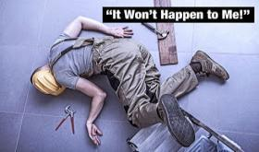
The 5 Common Myths
Myth – Workers solely are responsible for accidents
Reality – Employers are primarily responsible for ensuring safety in their organizations . Safety culture is set by them
Myth – It won’t happen to me
Reality – Accidents can happen to anybody, at any time and for any reasons, particularly due to carelessness, overconfidence and management system failures among others

Slide 34
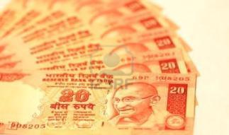
The 5 Common Myths
Myth – Health & Safety costs negatively impact the profitability and therefore should be avoided
Reality – Unhealthy & de-motivated employees negatively impact productivity. Accidents and injuries result in loss of profits and adversely impact the brand image. It is also punishable by Law.
If you are an influencer in your company, change these misconceptions NOW
Lead from the front, lead by example

Slide 35
We work for safety, social security and skill developement

Slide 36
IT IS NOT CONSTRAINT OF FUND BUT CONSTRAINT OF ATTITUDE WHICH NEEDS TO BE ADDRESSED TO ACHIEVE SOCIAL SECURITY FOR MIGRANT WORKERS

Slide 37
ATTITUDE
A+T+T+I+T+U+D+E 1+20+20+9+20+21+4+5 = 100%
It is OUR ATTITUDE towards Life and Work that makes OUR Life 100% ! ! !

Slide 39
CHALLENGES
C - Country with Vast numbers
H - Health care infrastructure limited
A - Ageing population
L - Lack of Uniformity in Schemes
L - Large Scale misuse
E – Engaging who can afford to pay
N – Networking of schemes and agencies like
Asha, Agwanwadi & Registered Agencies
G - Guiding use of information Technology
E - Educating People
S - Solution based Grievance Mechanism

Slide 40
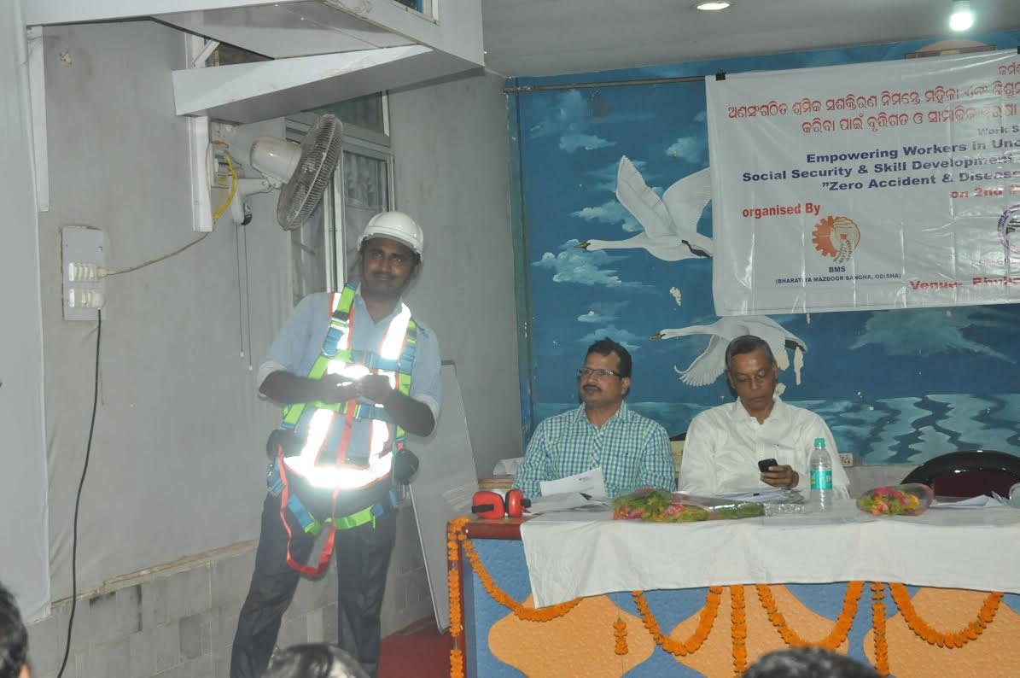

Slide 41
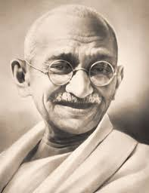
Let us do something which can wipe out tears of the poor and the needy.
…….The Father of the Nation

Slide 42
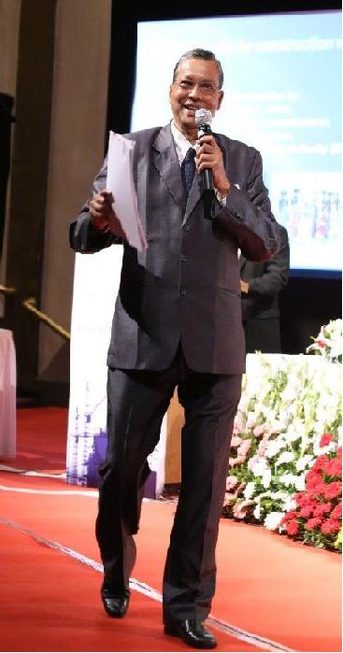
Former Insurance commissioner,
ESI Corporation, Govt. of India & Communication Advisor, IRDAI AND
NOW @ INDO -GERMAN FOCAL POINT FOR INDIA,DGUV
Mail Id-focalpointindia.dguv@gmail.com
Thank You

